Slide 1

Statistical Analysis of Basketball Players’ Performance for the NBA season of 2018-19 Author: Himesh Buch Submitted to: Lynn A. Agre, MPH, PhD Statistics 467/567 August 11, 2020

Slide 2
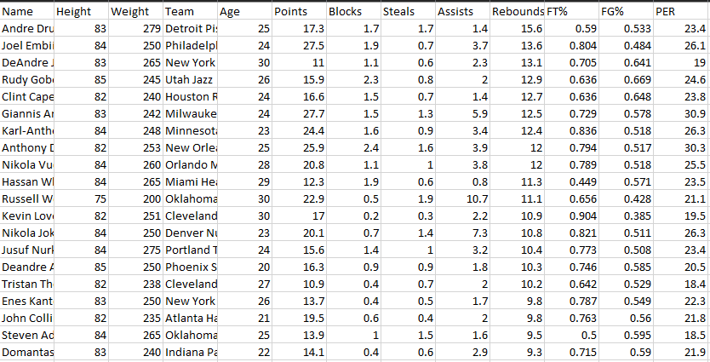
Overview
Data retrieved from Kaggle
It contains variables like points, blocks, assists, and steals per game, just to name a few
Here’s a quick snippet:

Slide 3
Understanding variables
Name: Player names (discrete, string)
Team: Team names (discrete, string)
Points: Point score by a player in a game (continuous, numeric)
Assists: Assists made by players per game (continuous, numeric)
Steals: Number of times the ball is stolen from the opposition in a game (continuous, numeric)
Blocks: Number of blocked shots in a game (continuous, numeric)
Rebounds: Getting possession after a failed shot (continuous, numeric)
FT%: Points earned from free throw line (continuous, numeric)
FG%: Points earned that are not FT and fouls (continuous, numeric)
PER: A widely used statistic to understand player’s efficiency (continuous, numeric)
Binary: All of the above, with a value of either 0 or 1 (continuous, numeric)

Slide 4
Hypothesis to be tested
Most valuable Player (MVP) of the 2018-19 NBA season
Best defensive player of the 2018-19 NBA season
What predictors help the most in determining above hypothesis?
Is Player Efficiency Rating (PER) a good factor for this analysis?

Slide 5
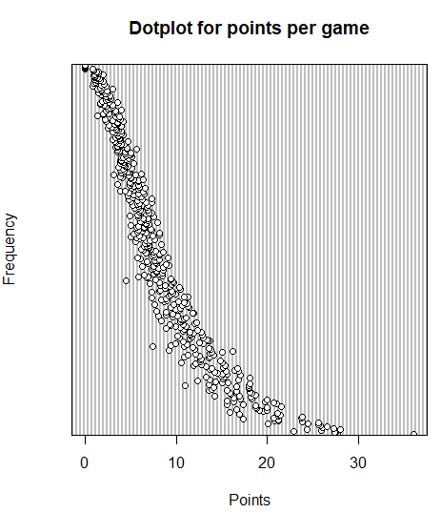
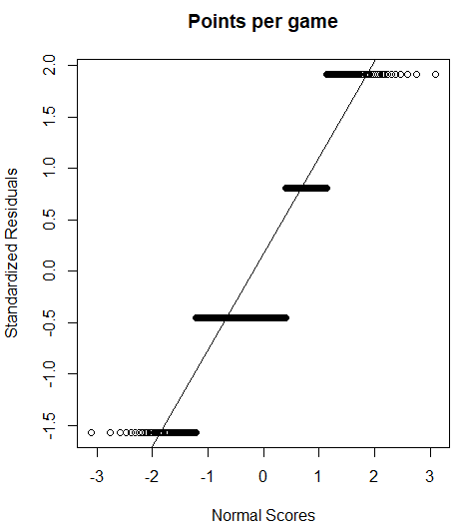
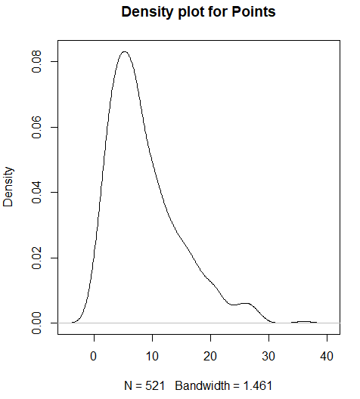
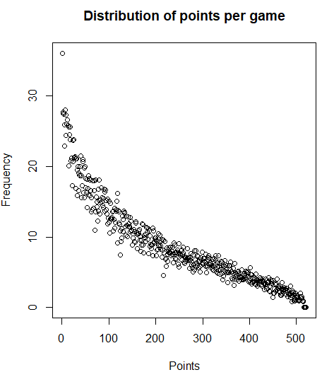
Methods used (Univariate Analysis)
Mean, Median, Mode, Frequency Count Standard Deviation, Variance, Standard Error, Skewness (to understand data distribution)
Plots: Dot plot, Box plot, Normal Probability plot, Histogram, P-P plot, Scatterplot
Here are some plots:
Notes:
Here are some methods that I used for univariate analysis. Methods like calculating mean median and mod, calculaitinf frequency count, standard deviation, skewness etc. All these methids mainly help in understanding the distribution of the dataset. Since we are talking about distribution of it, here are some graphs ro better understand the spread of each variable. Not only these but dot plots, box plots, normal probability plots, histogram, scatter plots etc were also used to better understand how each variable is distributed.

Slide 6
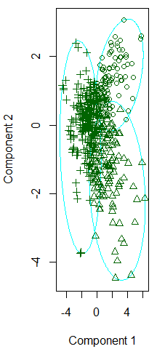
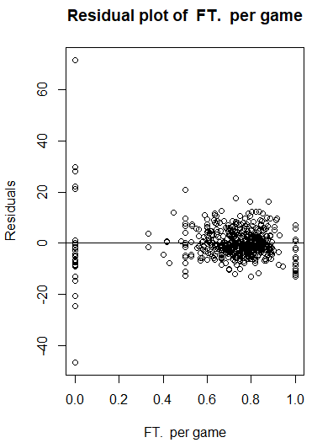
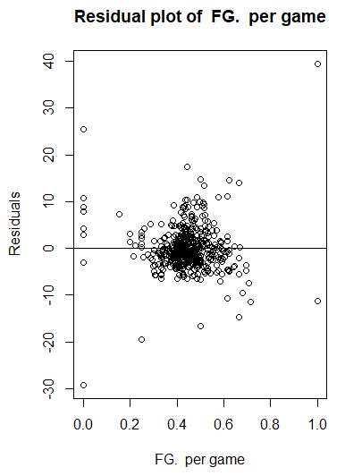
Methods used (Bivariate and Multivariate Analysis)
Transformation of variable, Hotelling T² CI, Variance-Covariance and Correlation matrix, eigenvalues and eigen vectors
MANOVA, Goodness of Fit Test, Residual Plots
Likelihood Ratio test, Forward Stepwise Regression
Classification Methods: K-means Cluster and Factor Analysis
Notes:
For bivariate analysis, methods like MANOVA, Varaince co variance matrix, correlation matrix, eif=gen values and eigen vectors were computed. For multivariate analysis methods like residual plots and computing residuals for each variables, likelihood ratio test, and forward stepwise regression is used. As seen in the second and third figure, we can see that the residual plots are normally distributed along the line. For likeliehood ratio test, all the previously explained variables were converted into a binary form by using some sort of standard logic. For instance, in order to conver the variable points ina binary form, I decided that all the values above 15 will be replaced with 1 and all the values below 15 will be replaced with 0. The same logic is applied for other variables as well. The reason of specifically choosing the value 15 is because the average of all the values of points is 15
Not only that some classification methods like k means clustering and factor analysis are used. Figure one is a graph of k means cluster where there were 3 groups selected.

Slide 7
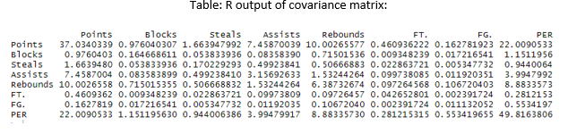
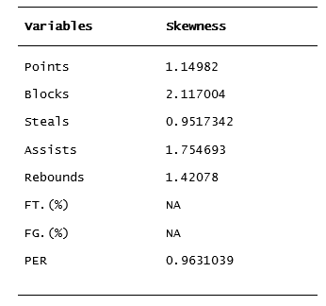
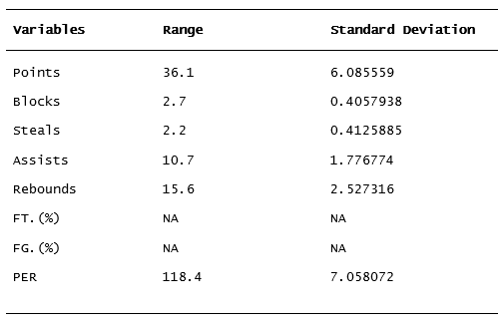
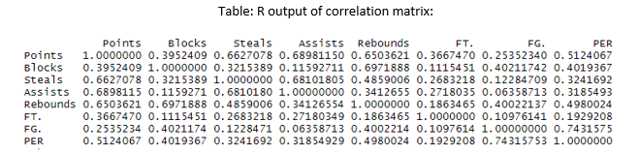
Tables
Notes:
Here is another set of figures which helped in deriving different conclusions. The tables to the left help in understandning ghr distribution of the variables and the tables to the right are just variance co varance and corelaion matrices. Looking at the tables to the left, we can see that most variables are skewed to the right where very few variables such as steals are normally distributed. If the variables are very much skewed to either side then that means that thise variables may contain some outliers which will not help in getting pro

Slide 8
Results
Results suggest that formula for PER isn’t as affective (at least for this analysis)
Looking at the results of Forward Stepwise Regression (multivariable regression), PRE prefers one variable over other
The formula proves above statement
Came up with a new formula and created a new column named “mvp_index”
Notes:
As explained earlier, the results suggest that the variable PER is not as effective as it may seem. Now I could be wrong but specifiacally for this analysis it did not give appropriate results. First I looked up the formula of PER and just by looking at it one could say that it is preferring one variable over other. But to be completely sure, after running forward stepwise regression I found out that the variables free throw percent, points and assists have the highest r squred values meaning they are most likely to affect the result which in our case is Player efficiency rating. The reason why I say that PER isn’t useful here is that for finding whi the offensive player is you cant possibly say that the variable Points scored per game and the variable Blocks made per game have equal importance. Same logic applies when finding the best player overall. In order to over come this I had to give all the variables some sort of weight and create a different formula for finding who the MVP should be for the season. I created a column mvp_index specifically to see how the results differ when compared with PER.

Slide 9
Results
Using PRE as a standard statistic puts Zhau Qi as the MVP, which by looking at his stats is no where close to the stats of the actual MVP
Using mvp_index to determine the MVP gives James Harden
Actual MVP of the season is Giannis Antetokounmpo who is at number two in the analysis using mvp_index and at number six
MVP Index of Giannis Antetokounmpo = 43.4528
MVP Index of James Harden = 48.9884
Notes:
According to the variable PER the mvp of the nba season 2018-19 should be Zhau Qi which is by looking at his stats is no where near becoming a MVP. Hence, it proves that PER isn’t actually the best variable to look at for this study. Now by looking at the variable mvp_index, the MVP should be James Harden, who was at top according to my study. The actual mvp of the season is Giannis Ante who is at number 2 if mvp_index is used and at number 6 if per is used. Looking at the mvp_index scores of both of these players we can say that the study wasn’t too off and almost predicted the MVP by analyzing limited number of variables.

Slide 10
Results
Had to change formula to determine the Defensive Player of the season
Created a new column “defensder_index” with the new formula
Actual Defensive Player of the season is Rudy Golbert, and accrding to the analysis it is Russell Westbrook
Defensive Index of Rudy Golbert = 17.92
Defensive Index of Russell Westbrook = 13.78
Notes:
Same as MVP, in order to find defensive player of the season, I had to change the formula again and giver variables like assists, blocks and steals more important thsan the others. In order to do so, I created another column named defender_index. Now keep in mind that PER is used in determining both the MVP and defensive player of the season with the same formula, but for my study I had to come up with different formulas. According to my analysis, the defensive player should be Russle westbrrok but the actual defensive player is Rudy Golbert for the season of 2018-19. Russle westbrok came out at the top in my analysus where rudy gilbert was at number 4.Looking at the defender_index score of both of these players, it is close but not as close as it should’ve been. The results are still acceptable and reasonable

Slide 11
Discussion
Additional variables like different fouls, and blocks and rebounds missed are very important but missing
Other variables like Height, Weight, and Age could have been utilized
The main impact of the study is that the PER is not as efficient as it looks
The analysis overcame those limitations and answered the questions that could not be answered by PER and more

